Slide 1
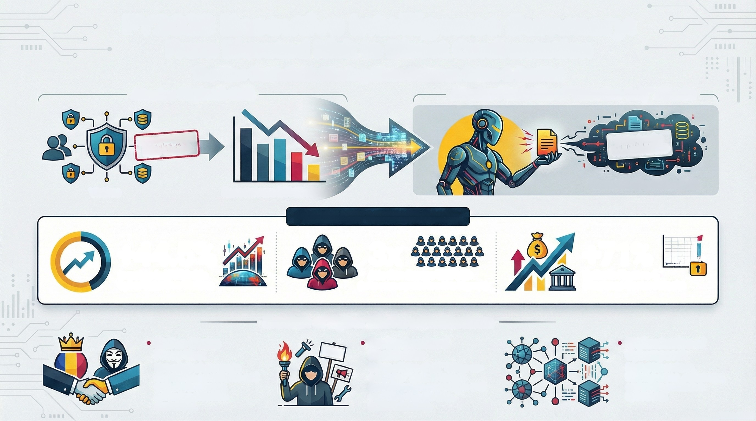
Executive Intelligence Summary:
From Elevated Risk to Direct Confrontation
The New Battlefield: Blurring Lines Between Crime & Conflict
Attacker Playbook Shift
Attacker Pivot: Rise of "Extortion-Only" Attacks
Ransom Payment
REFUSED
Data Leaks
THREATENED
Victims
Ransomware ROI Declines
Focus: Leaking Stolen Data
2025 KEY METRICS PANEL
+44.5%
Increase in Worldwide
Cyber Extortion Victims
3x
+71% M
Spike in Finance &
Insurance Sector Attacks
Attacker Groups TRIPLED
(Active actors expanded from 33 to 89 groups)
Erosion of Cyber Warfare Distinctions
• Nation-States
Professionalized
Hacktivists:
Using off-the-shelf "Crime-as-
a-Service" tools to launch
destabilization campaigns and
cognitive attacks (e.g.,
misinformation).
'Balkanization of
Cyberspace':
Digital blocs form,
blurring crime, espionage,
and propaganda in a
hybrid war.
Proxy Use:
PROTEST
Use criminal groups to
destabilize adversaries and
gather intelligence,
achieving plausible
deniability.

